Slide 1



Slide 2

Chapter 7: Memory Management
Background
Swapping
Contiguous Memory Allocation
Paging
Structure of the Page Table
Segmentation
Example: The Intel Pentium

Slide 3
Objectives
To provide a detailed description of various ways of organizing memory hardware
To discuss various memory-management techniques, including paging and segmentation
To provide a detailed description of the Intel Pentium, which supports both pure segmentation and segmentation with paging

Slide 4
Basic Terminology
Address Binding
Base and Limit Registers
Absolute and Relocatable code
Logical and Physical Address
Routines

Slide 5
Address Binding
A program, to be executed, must be brought to main memory. The instructions that use addresses in a program, must be bound to proper address space in main memory.
Address binding is a scheme that performs this job. It can be thought as a mapping from one address space to another. There are bindings available as follows: Compile time binding Load time binding and Execution time binding

Slide 6
Base And Limit registers
Base and limit registers are special hardware registers. When a process is run, the base register is loaded with the physical location where the process begins in memory. The limit register is loaded with the length of the process. In other words, they define the logical address space

Slide 7
Absolute and Relocatable Code
Absolute Code: A code used when the addresses in a program are to be written in machine language exactly as they will appear when the instructions are executed by the control circuits.
Relocatable Code: A code generated by an assembler or compiler, and in which all memory references needing relocation are either specially marked or relative to the current program-counter reading.

Slide 8
Logical and Physical address
An address generated by the CPU is commonly refereed as Logical Address, whereas the address seen by the memory unit, that is one loaded into the memory address register of the memory is commonly refereed as the Physical Address. The compile time and load time address binding generates the identical logical and physical addresses. However, the execution time address binding scheme results in differing logical and physical addresses.
The set of all logical addresses generated by a program is known as Logical Address Space, whereas the set of all physical addresses corresponding to these logical addresses is Physical Address Space. Now, the run time mapping from virtual address to physical address is done by a hardware device known as Memory Management Unit. Here in the case of mapping the base register is known as relocation register. The value in the relocation register is added to the address generated by a user process at the time it is sent to memory. Let's understand this situation with the help of example: If the base register contains the value 1000,then an attempt by the user to address location 0 is dynamically relocated to location 1000,an access to location 346 is mapped to location 1346.
The user program never sees the real physical address space, it always deals with the Logical addresses. As we have two different type of addresses Logical address in the range (0 to max) and Physical addresses in the range(R to R+max) where R is the value of relocation register. The user generates only logical addresses and thinks that the process runs in location to 0 to max. As it is clear from the above text that user program supplies only logical addresses, these logical addresses must be mapped to physical address before they are used.

Slide 9
Routines
A section of a program that performs a particular task. Programs consist of modules, each of which contains one or more routines. The term routine is synonymous with procedure, function, and subroutine.

Slide 10
Typical instruction execution cycle
Fetch instruction → Decode
Fetch operands (depending on the instruction)
Execute the instruction on the operands
Store the results in memory
*** operand
1) In computers, an operand is the part of a computer instruction that specifies data that is to be operating on or manipulated and, by extension, the data itself. Basically, a computer instruction describes an operation (add, subtract, and so forth) and the operand or operands on which the operation is to be performed.
2) In mathematics, an operand is the object of a mathematical operation.

Slide 11
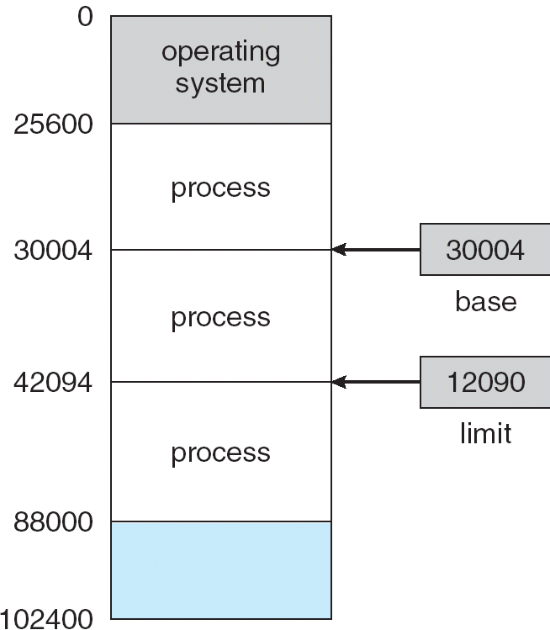
Base and Limit Registers
Each process has a separate memory space
A pair of base and limit registers define the logical address space

Slide 12

User program go through several steps before being run on memory

Slide 13
Different address representations
Symbolic Address (e.g., int i, double j, float k)
Logical Address (i.e., offset)
Physical Address

Slide 14
Binding of Instructions and Data to Memory
Address binding of instructions and data to memory addresses can happen at three different stages
  Compile time: If memory location known a priori, absolute code can be generated; must recompile code if starting location changes (for example, if we know prior that a user process resides starting at location R, then the generated compiler code will start at that location and extend up from there.)
  Load time: Must generate relocatable code if memory location is not known at compile time: i.e., bind logical address to physical address.
  Execution time: if the process can be moved during its execution from one memory segment to another, then binding must be delayed until run time. Needs hardware support for address maps (Dynamic Binding) (e.g., base and limit registers, MMU)

Slide 15
Logical vs. Physical Address Space
The concept of a logical address space that is bound to a separate physical address space is central to proper memory management
  Logical address – generated by the CPU; also referred to as virtual address
  Physical address – address seen by the memory unit
Logical and physical addresses are the same in compile-time and load-time address-binding schemes; logical (virtual) and physical addresses differ in execution-time address-binding scheme

Slide 16
Memory-Management Unit (MMU)
Hardware device that maps virtual to physical address
In MMU scheme, the value in the relocation register is added to every address generated by a user process at the time it is sent to memory
The user program deals with logical addresses; it never sees the real physical addresses

Slide 17
Address Mapping Table
CPU : Real Address
logical physical
Memory
0
500
0
CPU
500:
500
20000

Slide 18


Base register

Slide 19
Dynamic Loading
Routine is not loaded until it is called
Better memory-space utilization; unused routine is never loaded
Useful when large amounts of code are needed to handle infrequently occurring cases
No special support from the operating system is required implemented through program design
Loading → Occupy memory space

Slide 20
Dynamic Linking
Linking postponed until execution time
Small piece of code, stub, that indicates how to locate the appropriate memory-resident library routine, or how to load the library if the routine is not already present.
When the stub is executed, it checks the see whether the needed routine is already in memory. If not, the program loads the routine into memory.
Either way, Stub replaces itself with the address of the routine, and executes the routine
Operating system needed to check if needed routine is in another process’ memory space, or that can allow multiple processes to access the same memory addresses.
Dynamic linking is particularly useful for libraries
This feature can be extended to library updates (such as bug fixes). A library may be replaced by a new version, and all programs that reference the library will automatically use the new version. Thus, only programs that are compiled with the new library version are affected by the incompatible changes incorporated in it. Other programs linked before the new library was installed will continue using the older library. This System also known as shared libraries

Slide 21
Overlays
The overlays is used to enable a process to be larger than the amount of memory allocated to it.
The idea of overlays is to keep in memory only those instructions and data that are needed at any given time.
When other instructions are needed, they are loaded into space occupied previously by instructions that are no longer needed.
As an example consider a two pass assembler. During pass 1, it constructs a symbol table; then, during pass 2, it generates machine-language code.

Slide 22
Contd..
We may partition such an assembler into pass 1 code, pass 2 code, the symbol table, and common support routines used by both pass 1 and pass 2.
Assume that the sizes of these components are as follows:
        Pass 1 70 KB
        Pass 2 80 KB
        Symbol table 20 KB
        Common routines 30 KB
To load everything at once, it is required at least 200 KB of memory. If only 150 KB is available, the process cannot be run.
Note that Pass 1 and Pass 2 do not need to be in memory at the same time.
So, we define two overlays: Overlay A is the symbol table, common routines, and pass 1 and Overlay B is the symbol table, common routines, and pass 2.

Slide 23
Swapping
A process needs to be in memory to be executed. A process can be swapped temporarily out of memory to a backing store, and then brought back into memory for continued execution
Backing store – It is commonly a fast disk. It must be large enough to accommodate copies of all memory images for all users; must provide direct access to these memory images. The system use to maintains a ready queue consisting of all processes whose memory images are on the backing store.
Roll out, roll in – swapping variant used for priority-based scheduling algorithms;
  lower-priority process is swapped out
  higher-priority process can be loaded and executed
  Major part of swap time is transfer time; total transfer time is directly proportional to the amount of memory swapped
  Modified versions of swapping are found on many systems (i.e., UNIX, Linux, and Windows)
  System maintains a ready queue of ready-to-run processes which have memory images on disk

Slide 24
Contd..
Assume a multiprogramming environment with a round robin CPU-scheduling algorithm.
When a quantum expires, the memory manager will start to swap out the process that just finished, and to swap in another process to the memory space that has been freed. Fig on next slide.
In the meantime, the CPU scheduler will allocate a time slice to some other process in memory.
When each process finishes its quantum, it will be swapped with another process.
The memory manager can swap processes fast enough that some processes will be in memory, ready to execute, when the CPU scheduler wants to reschedule the CPU.
The quantum must also be sufficiently large that reasonable amounts of computing are done betweens swaps.

Slide 25

Schematic View of Swapping

Slide 26
Context-switch time in Swapping
Assume that user process is of 10 MB and the backing store is a standard hard disk with a transfer rate of 40 MB per second. The actual transfer of 1 MB process to or from memory takes:
Size of user process = 10 MB
Transfer rate = 40 MB/sec
Average latency = 8 millisec
No head seeks overhead
➔ Transfer time = 10000 KB / 40000 KB per sec
= ¼ second
= 250 millisec
➔ Swap time = 258 millisec
➔ Total swap time = 516 millisec
In RR scheduling, the time quantum should be larger than 0.516 seconds
How can reduce swap time? Swap only what is actually used.
  Keep the system info of any changes in memory

Slide 27
Swapping in Current System
Standard swapping is used in few systems
  Why? It requires too much swapping time and provides too little execution time to be a reasonable memory management solution.
  Modified versions of swapping
Swapping is normally disabled
  Will start if many processes are running and use much memory
Early PCs: ran multiple large process by using Swapping
  Windows 3.1

Slide 28
Contiguous Allocation
The main memory must accommodate both the operating system and the various user processes.
Main memory usually into two partitions: one for the resident operating system, and one for the user processes.
  The operating can be placed in either the low memory or high memory but by depending upon the location of interrupt vector. Since interrupt vector is often in low memory, so operating system is in low memory.
  The user processes is in High memory

Slide 29
Memory Protection
To protect the operating system from user processes, and protecting user processes from one another. The memory protection can be provided.
By using a relocation register with a limit register.
The relocation register contains the value of the smallest physical address; the limit register contains the range of logical addresses (for e.g. relocation = 100040 and limit = 74600).
With relocation and limit registers, each logical address must be less than the limit register; the MMU maps the logical address dynamically by adding the value in the relocation register. This mapped address is sent to memory.
Fig on next slide.

Slide 30


limit
register
relocation
register
logical
Physical
Address
+

Slide 31
Single-partition allocation
To protect user processes from each other, and from changing operating-system code and data
Base register contains value of smallest physical address
Limit register contains range of logical addresses – each logical address must be less than the limit register
MMU maps logical address dynamically

Slide 32
Contiguous Allocation (Cont.)
Multiple-partition allocation
  One of the simplest method for memory allocation is to divide memory into several fixed size partitions. Each partition may contain exactly one process.
  In this multiple partition method, when a partition is free, a process is selected from the input queue and is loaded into the free partition. When process terminates the available partition becomes available for another process.
  Initially, all memory is available for user processes, and is considered as one large block of available memory, a hole.
  Hole – block of available memory; holes of various size are scattered throughout memory
  When a process arrives, it is allocated memory from a hole large enough to accommodate it
  Operating system maintains information about:
  a) allocated partitions b) free partitions (hole)
OS
OS
OS
OS
process 5
process 5
process 5
process 5
process 9
process 9
process 8
process 10
process 2
process 2
process 2
process 2

Slide 33
Contd..
When process arrives and needs memory, the system searches this set for a hole that is large enough for this process.
If the hole is too large , it is spilt into two parts: one part is allocated to the arriving process; the other is returned to the set of holes.
When a process terminates, it releases its block of memory, which is then placed back in the set of holes.
If the new hole is adjacent to other holes, these adjacent holes are merged to form one larger hole.
At this point, the system may need to check whether there are processes waiting for memory and whether this newly freed and recombined memory could satisfy the demands of any of these waiting processes.

Slide 34
Dynamic Storage-Allocation Problem
How to satisfy a request of size n from a list of free holes
The three types of strategies are the most common ones used to select a free hole from the set of available holes.
First-fit: Allocate the first hole that is big enough
Best-fit: Allocate the smallest hole that is big enough; must search entire list, unless ordered by size
  Produces the smallest leftover hole
Worst-fit: Allocate the largest hole; must also search entire list
  Produces the largest leftover hole
First-fit and best-fit better than worst-fit in terms of speed and storage utilization

Slide 35
Example
0
0
0
OS
P1
OS
400
300
400
P1
H1
H1
1000
1000
P3
P3
1400
1400
H2
H2
2000
2000
P4
P4
2600
2600
H3
H3
3000
3000
First-fit

Slide 36
Example
0
0
0
OS
P1
OS
400
300
400
H1
H1
1000
1000
P3
P3
1400
P1
1400
H2
H2
2000
2000
P4
P4
2600
2600
H3
H3
3000
3000
Worst-fit

Slide 37
Example
0
0
0
OS
P1
OS
400
300
400
H1
H1
1000
1000
P3
P3
1400
1400
H2
H2
2000
2000
P4
P4
2600
2600
P1
H3
H3
3000
3000
Best-fit

Slide 38
Contd..
These algorithms, however, suffer from External Fragmentation.
As processes are loaded and removed from memory, the free memory space is broken into little pieces.
External fragmentation exists when enough total memory space exists to satisfy a request, but it is not contiguous; storage is fragmented into a large number of small holes.
This fragmentation problem can be severe. In the worst case, we could have a block of free (or wasted) memory between two processes.
If all this memory were in one big free block, we might be able to run several more processes.

Slide 39
Fragmentation
0
0
0
OS
P2
OS
400
400
H1
700
H1
1000
1000
P3
P3
1400
H1
0
1400
H2
H2
2000
H2
2000
P4
P4
2600
H3
2600
H3
1400
H3
3000
3000

Slide 40
Fragmentation
External Fragmentation
  total memory space exists to satisfy a request, but it is not contiguous
Internal Fragmentation
  allocated memory may be slightly larger than requested memory; this size difference is memory internal to a partition, but not being used
    Hole: 1000 bytes, Process: 998 bytes → 2 bytes free
    But, less than overhead of tracking it this 2 free bytes of hole → useless
    Solution? ➔ Fixed sized block
Reduce external fragmentation by compaction
  Shuffle memory contents to place all free memory together in one large block
  Compaction is possible only if relocation is dynamic, and is done at execution time
  I/O problem
    Latch job in memory while it is involved in I/O
    Do I/O only into OS buffers
Another process solution to the external fragmentation problem is to permit the logical address space of a process to be noncontiguous, thus allowing a process to be allocated physical memory wherever the latter is available.
Two complementary techniques achieve this solution : Paging and Segmentation

Slide 41
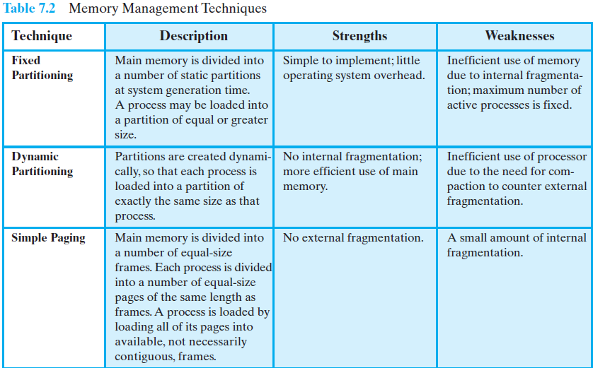
Memory management Technique

Slide 42
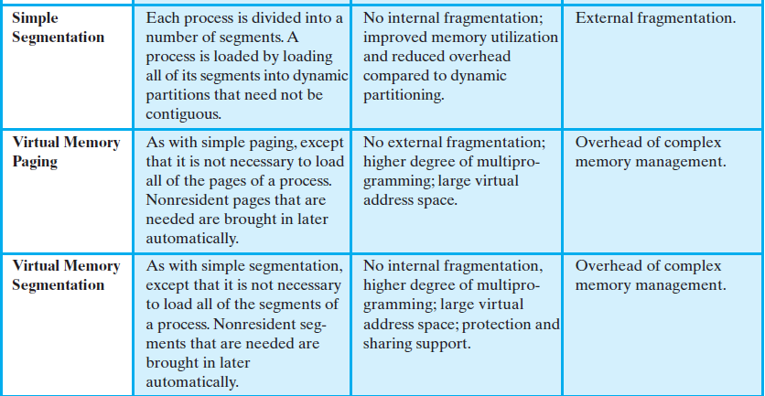
Contd..
Technique | Description | Strength | Weakness

Slide 43
Paging
Paging is Memory Management Scheme that permits the Physical address space of a process to be noncontiguous.
Paging avoids the considerable problem of fitting the varying-sized memory chunks onto the backing store, from which most of the previous memory management schemes suffered.
Traditionally, support for paging has been handled by hardware. However, recent designs have implemented paging by closely integrating the hardware and operating system, especially on 64-bit microprocessors.

Slide 44

Paging Example by Galvin
Page name as issued by CPU

Slide 45
Paging
Paging
  is a scheme that permits address space to be noncontiguous
Basic Method
  Divide physical memory into fixed-sized blocks called frames (size is power of 2, between 512 bytes and 8192 bytes).
  Divide logical memory into blocks of same size called pages.
  The page size (like the frame size) is defined by the hardware. The size of page is typically a power of 2, varying between 512 bytes and 16 MB per page, depending on the computer architecture.
  When a process is to be executed, its pages are loaded into any available memory frames from the backing store.
  The backing store is divided into fixed-sized blocks that are of the same size as the memory frames.
  Keep track of all free frames.
  Set up a page table to translate logical to physical addresses.
  Internal fragmentation.

Slide 46
Paging Example by Stalling
Next Slide fig. illustrates the use of pages and frames. At a given point in time.
Some of the frames in memory are in use and some are free. A list of free frames is maintained by the operating system. Process A, stored on disk, consists of four pages. When it comes time to load this process, the operating system finds four free frames and loads the four pages of process A into the four frames (Figure b).
Process B, consisting of three pages, and process C, consisting of four pages, are subsequently loaded. Then process B is suspended and is swapped out of main memory.
Later, all of the processes in main memory are blocked, and the operating system needs to bring in a new process, process D, which consists of five pages.

Slide 47
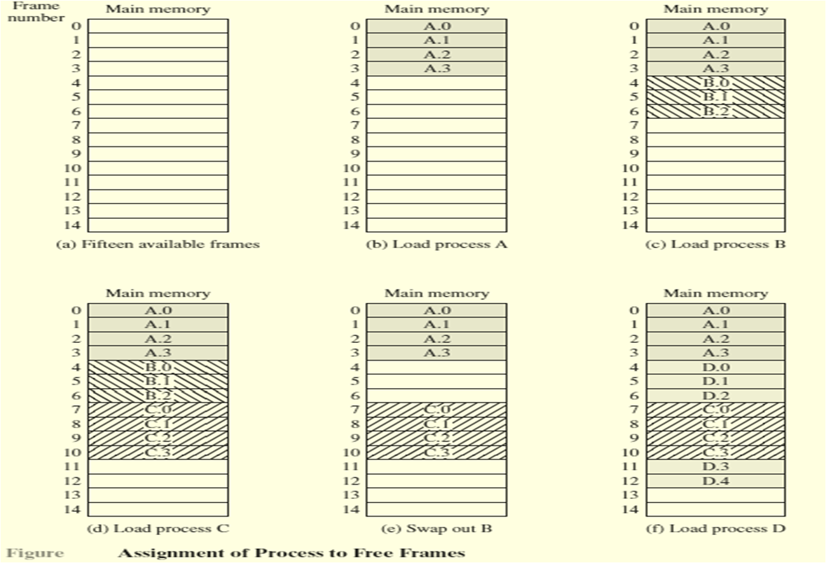
Fig.

Slide 48
Address Translation Scheme
Address generated by CPU is divided into 2 parts:
  Page number (p) – The page number is used as an index into a page table. The page table contains the base address of each page in physical memory
  Page offset (d) – combined with base address to define the physical memory address that is sent to the memory unit
  For given logical address space 2^{m} and page size 2^{n}
page number
page offset
p
d
m - n
n

Slide 49

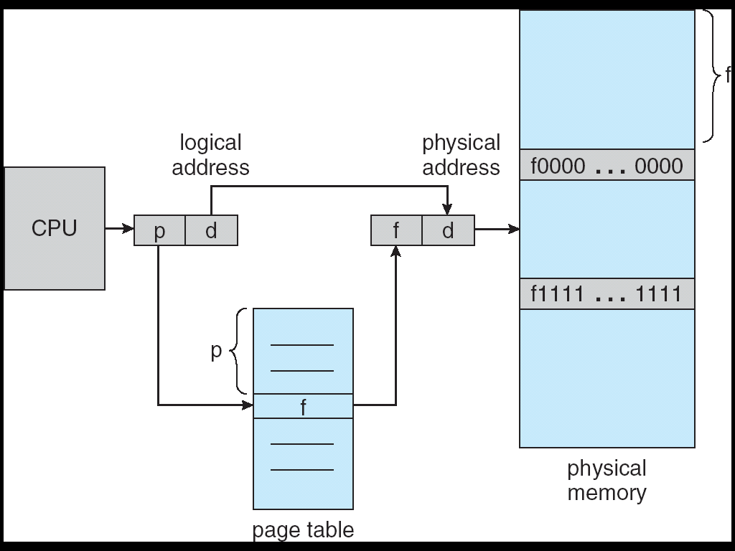

Slide 50



Slide 51
Paging Example By stalling
Next Page Fig.
In this example, 16-bit addresses are used, and the page size is 1K = 1024 bytes. The relative address 1502, in binary form, is 0000010111011110.With a page size of 1K, an offset field of 10 bits is needed, leaving 6 bits for the page number.
Thus a program can consist of a maximum of 2⁶ = 64 pages of 1K bytes each. As Figure b shows, relative address 1502 corresponds to an offset of 478 (0111011110) on page 1 (000001), which yields the same 16-bit number, 0000010111011110.

Slide 52
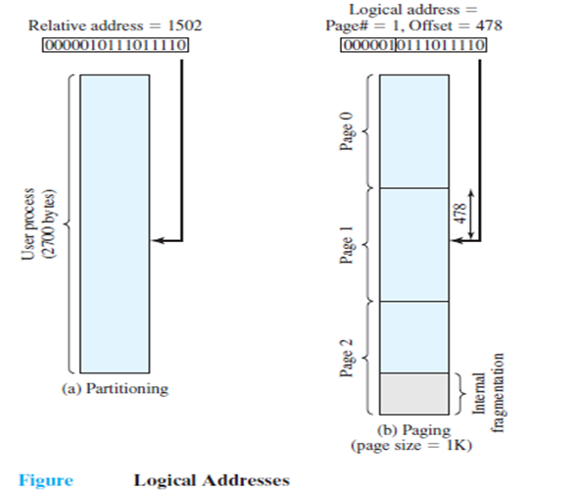
Figure: Logical Address

Slide 53
Contd..
The consequences of using a page size that is a power of 2 are twofold. First, the logical addressing scheme is transparent to the programmer, the assembler, and the linker. Each logical address (page number, offset) of a program is identical to its relative address.
Second, it is a relatively easy matter to implement a function in hardware to perform dynamic address translation at run time. Consider an address of n + m bits, where the leftmost n bits are the page number and the rightmost m bits are the offset. In our example (Figure b), n = 6 and m =10.
The following steps are needed for address translation:
  Extract the page number as the leftmost n bits of the logical address.
  Use the page number as an index into the process page table to find the frame number, k.
  The starting physical address of the frame is k × 2^{m}, and the physical address of the referenced byte is that number plus the offset. This physical address need not be calculated; it is easily constructed by appending the frame number to the offset.

Slide 54
Contd..
In our example, we have the logical address 0000010111011110, which is page number 1, offset 478.
Suppose that this page is residing in main memory frame 6 = binary 000110. Then the physical address is frame number 6, offset 478 = 0001100111011110 (Figure a next slide).

Slide 55
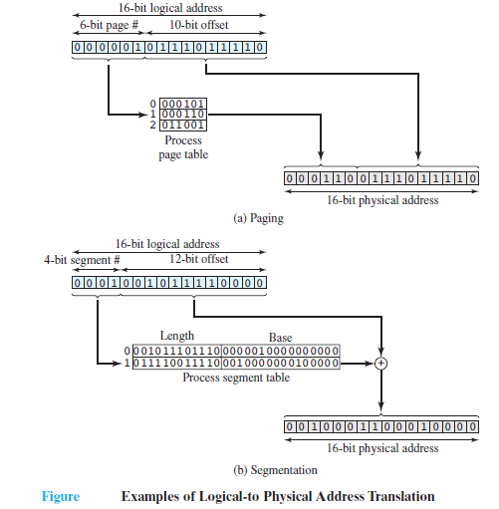
Fig: Example of Logical to physical address translation

Slide 56


Page size = 4 bytes
Physical memory = 32 bytes (8 pages)
e.g1>
  Logical address 0 = page 0, offset 0
  Page 0 = frame 5 (in page table)
  Logical address 0 = physical add 20
  ( = (5 X 4) + 0 )
e.g2>
  Logical address 3 = page 0, offset 3
  Physical add. = 23 (=(5X4) + 3)
e.g3>
Logical address ?
Page 0
Page 1
Page 2
Page 3
32-byte memory and 4-byte pages

Slide 57
Implementation of Page Table
Page table is kept in main memory
Page-table base register (PTBR) points to the page table. Changing page tables requires changing only this one register.
Page-table length register (PRLR) indicates size of the page table
In this scheme every data/instruction access requires two memory accesses. One for the page table and one for the data/instruction.
The two memory access problem can be solved by the use of a special fast-lookup hardware cache called associative memory or translation look-aside buffers (TLBs)
The TLB is associative, high speed memory. Each entry in the TLB consists of two parts: a key (or Tag) and a value.
When the associative memory is presented with an item, it is compared with all keys simultaneously. If an item is found, the corresponding value field is returned. The search is fast, the hardware, however, is expensive.

Slide 58
contd..
  The TLB is used with page tables in the following ways. The TLB contains only a few of the page-table entries. When a logical address is generated by the CPU, its page number is presented to the TLB. If the page number is found, its frame number is immediately available and is used to access memory. The whole task may take less than 10 percent longer than it would if an unmapped memory reference were used.
  If the page number is not in the TLB (known as a TLB miss), a memory reference to the page table must be made. When the frame number is obtained, it can be used to access memory.
  In addition, the page number and frame number can be added to the TLB, so that they can be easily referenced.
  If TLB is already full of entries, the operating system may select one for replacement as per the policy of LRU to random.
  Some TLBs store address-space identifiers (ASIDs) in each TLB entry – uniquely identifies each process to provide address-space protection for that process

Slide 59



Slide 60
Effective Access Time
Associative Lookup = ε time unit
Assume memory cycle time is 1 microsecond
Hit ratio – percentage of times that a page number is found in the associative registers; ratio related to number of associative registers
Hit ratio = α
Effective Access Time (EAT)
EAT = (1 + ε) α + (2 + ε)(1 – α)
= 2 + ε – α
An 80% hit ratio means that we find the desired page number in the TLB 80% of the time. If it takes 20 nanoseconds to search the TLB , and 100 nanoseconds to access memory, then a mapped memory access takes 120 nanoseconds when the page number is in the TLB.

Slide 61
Contd..
If we fail to find the page number in the TLB (20 nanoseconds), then we must first access memory for the page table and frame number (100 nanoseconds), and then access the desired byte in memory (100 nanoseconds), for a total of 220 nanoseconds.
To find the effective memory-access time, we must weigh each case by its probability:
  effective access time = 0.80 * 120 + 0.20 * 220
  = 140 nanoseconds
In this example, we suffer a 40 % slowdown in memory access time (from 100 to 140 nanoseconds)
    For a 98 % hit ration, we have
      Effective access time = 0.98 * 120 + 0.02 *220 = 122 nanoseconds
This increased hit rate produces only a 22 % slowdown in access time.

Slide 62
Memory Protection
Memory protection implemented by associating protection bit with each frame
Valid-invalid bit attached to each entry in the page table:
  “valid” indicates that the associated page is in the process’ logical address space, and is thus a legal page
  “invalid” indicates that the page is not in the process’ logical address space

Slide 63



Slide 64
Segmentation From Stalling
A user program can be subdivided using segmentation, in which the program and its associated data are divided into a number of segments.
It is not required that all segments of all programs be of the same length, although there is a maximum segment length. As with paging, a logical address using segmentation consists of two parts, in this case a segment number and an offset.
Because of the use of unequal-size segments, segmentation is similar to dynamic partitioning. In the absence of an overlay scheme or the use of virtual memory, it would be required that all of a program’s segments be loaded into memory for execution.
The difference, compared to dynamic partitioning, is that with segmentation a program may occupy more than one partition, and these partitions need not be contiguous.
Segmentation eliminates internal fragmentation but, like dynamic partitioning, it suffers from external fragmentation. However, because a process is broken up into a number of smaller pieces, the external fragmentation should be less.

Slide 65
Contd..
Whereas paging is invisible to the programmer, segmentation is usually visible and is provided as a convenience for organizing programs and data. Typically, the programmer or compiler will assign programs and data to different segments.
Another consequence of unequal-size segments is that there is no simple relationship between logical addresses and physical addresses.
Analogous to paging, a simple segmentation scheme would make use of a segment table for each process and a list of free blocks of main memory.
Each segment table entry would have to give the starting address in main memory of the corresponding segment. The entry should also provide the length of the segment, to assure that invalid addresses are not used.
When a process enters the Running state, the address of its segment table is loaded into a special register used by the memory management hardware.

Slide 66
Contd..
Consider an address of n + m bits, where the leftmost n bits are the segment number and the rightmost m bits are the offset.
In our example, (Fig A), n = 4 and m = 12. Thus the maximum segment size is 2¹² = 4096.The following steps are needed for address translation.
Extract the segment number as the leftmost n bits of the logical address.
Use the segment number as an index into the process segment table to find the starting physical address of the segment.
Compare the offset, expressed in the rightmost m bits, to the length of the segment. If the offset is greater than or equal to the length, the address is invalid.
The desired physical address is the sum of the starting physical address of the segment plus the offset.

Slide 67
Contd..
In our example, we have the logical address 0001001011110000, which is segment number 1, offset 752. Suppose that this segment is residing in main memory starting at physical address 0010000000100000.Then the physical address is 0010000000100000 + 001011110000 = 0010001100010000 (Figure B).
To summarize, with simple segmentation, a process is divided into a number of segments that need not be of equal size. When a process is brought in, all of its segments are loaded into available regions of memory, and a segment table is set up.

Slide 68
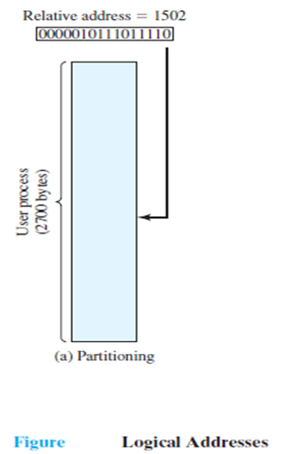
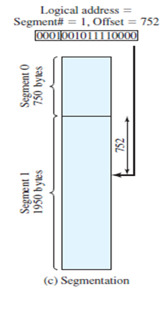
Fig A: Logical Address

Slide 69
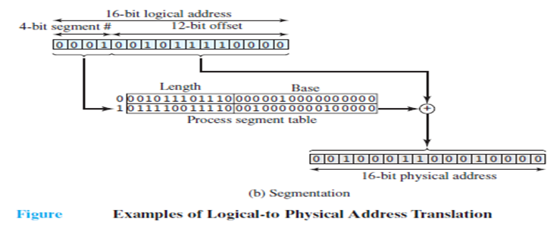
Fig B: Example of Logical to physical address translation

Slide 70
Segmentation Hardware By Galvin
Segmentation is a memory management scheme that supports this user view of memory.
A logical address space is a collection of segments. Each segment has a name and a length.
The addresses specify both the segment name and the offset within the segment.
The user therefore specifies each address by two quantities: a segment name and an offset.
A logical address consists of two parts: a segment number, s and an offset into that segment, d.
The segment number is used as an index into the segment table.
The offset d of the logical address must be between 0 and the segment limit.
If it is not, we trap to the operating system (logical addressing attempt beyond end of segment).
If this offset is legal, it is added to the segment base to produce the address in physical memory of the desired byte.
The segment table is essentially an array of base – limit register pairs.

Slide 71



Slide 72

1
1
4
2
3
4
2
3
user space
physical memory space

Slide 73
Segmentation Architecture
Logical address consists of a two tuple (Name and Length):
<segment-number, offset>,
E.g. the user program complied, and complier automatically constructs segments as follows (in C complier)
  The code
  Global variables
  The heap, from which memory is allocated
  The stacks used by each thread
  The standard C library

Slide 74
Segmentation Architecture (Cont.)
Segment table – maps two-dimensional physical addresses; each table entry has:
  base – contains the starting physical address where the segments reside in memory
  limit – specifies the length of the segment
Segment-table base register (STBR) points to the segment table’s location in memory
Segment-table length register (STLR) indicates number of segments used by a program;
segment number s is legal if s < STLR

Slide 75



Slide 76
Example
AS an example, consider the situation shown in next slide.
Five segment numbered from 0 through 4. These segments are stored in physical memory as shown.
The segment table has a separate entry for each segment, giving the beginning address of the segment in physical memory (or base) and the length of that segment (or limit).
For example, segment 2 is 400 bytes long and begins at location 4300.
Thus, a reference to byte 53 of segment 2 is mapped onto location 4300 + 53 = 4353.
A reference to segment 3, byte 852, is mapped to 3200 (the base of segment 3) + 852 = 4052.
A reference to byte 1222 of segment 0 would result in a trap to the operating system, as this segment is only 1,000 bytes long.

Slide 77



Slide 78


